Slide 1


Slide 2
UNH SEDS
UNH SEDS Civil Engineering Senior Design Project

Slide 3
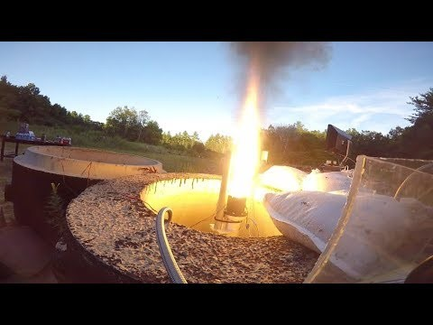
Current Projects
Payload & Recovery
Propulsion
Frame Design
Thrust Vectoring Research

Slide 4
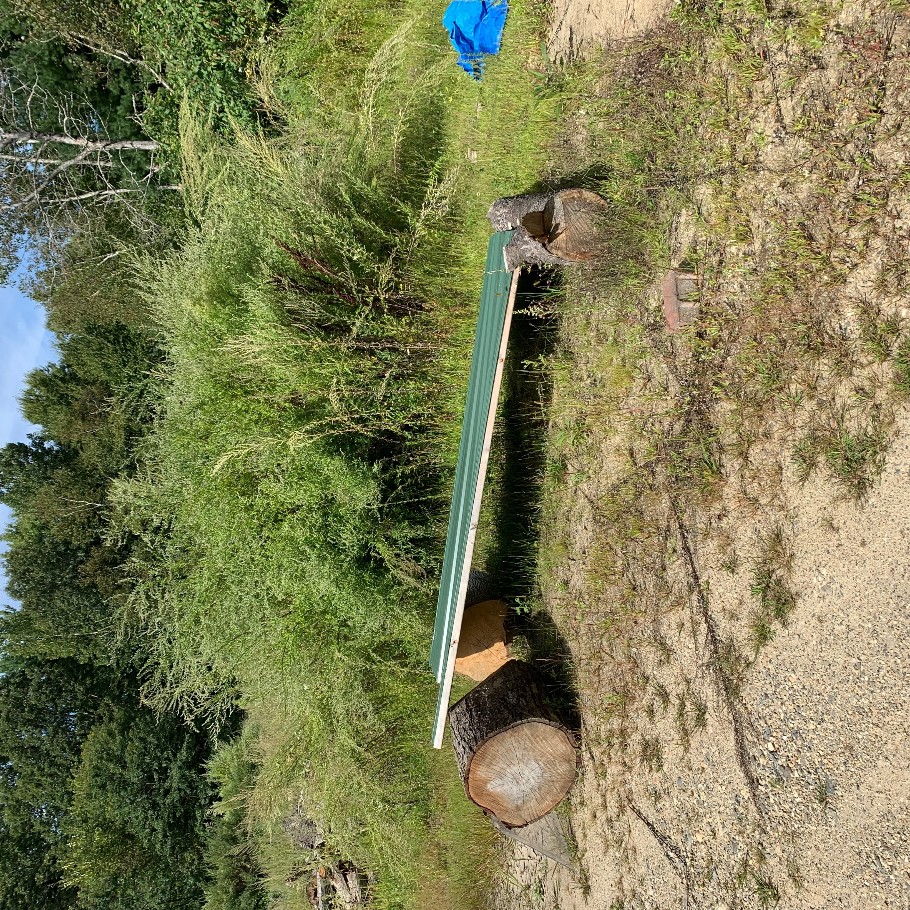
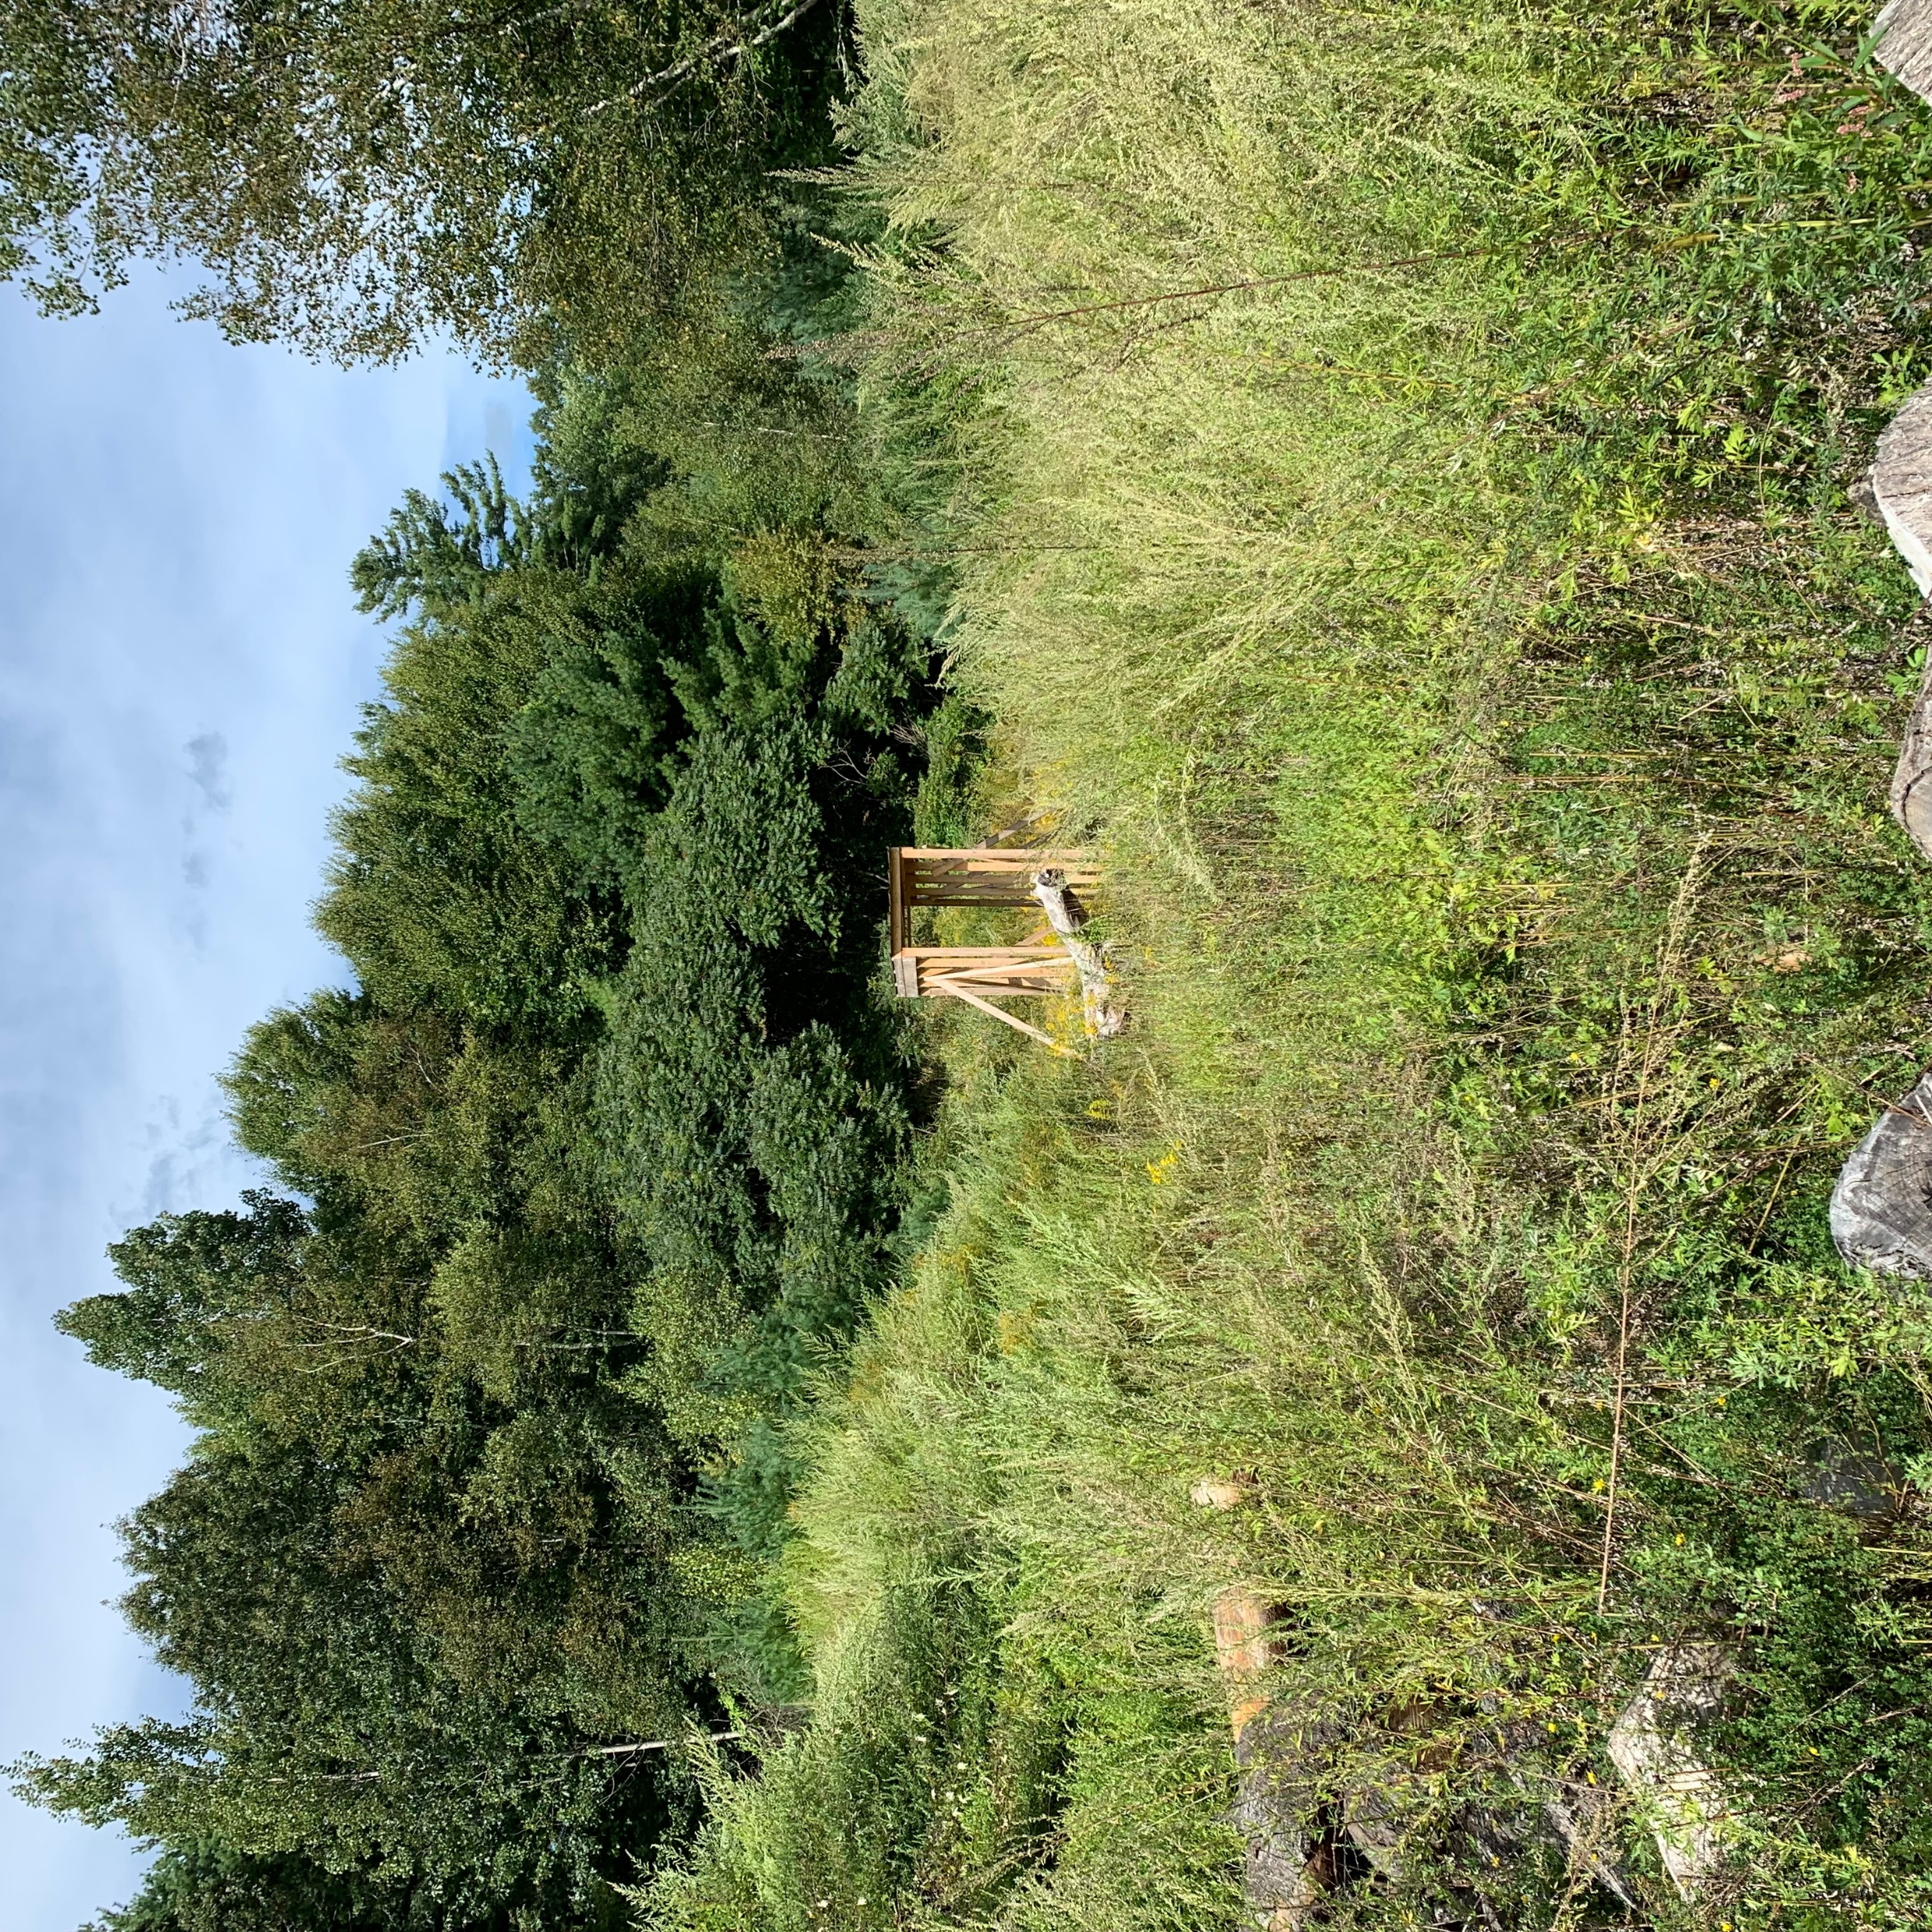
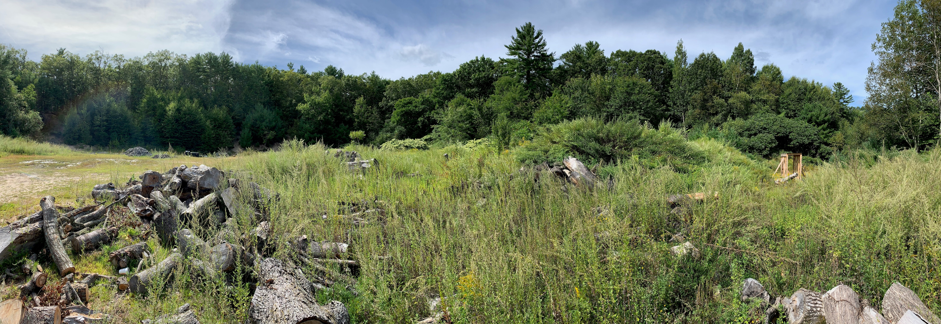
What we have to protect us…

Slide 5
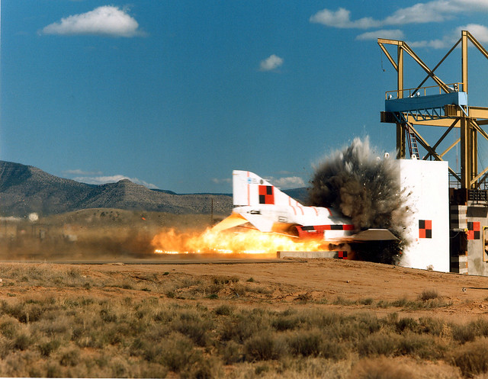
Senior Design Project
What we need…
A bunker that can withstand an impact from a failed test
A bunker with the ability to hold 8-10 people
A bunker that can be trailered from the back of a pick up truck

Slide 6
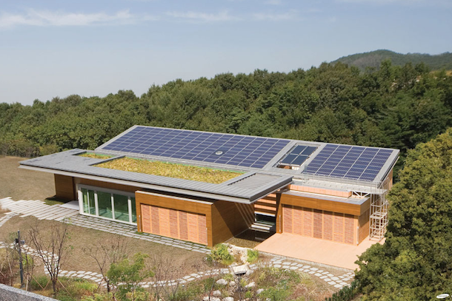
Senior Design Project
What we want…
A bunker that is heated for winter tests
A live feed of the test site during hot fire tests displayed through TV in bunker
A self sustaining bunker powered by renewable energy

Slide 7
Thank you

